Slide 1

The DnD ToolKit SWDV:691
Austin Glass

Slide 2
The Trouble with the TTRPG
Organization is difficult!
Encounters
Quests
Locations
Rules
Non-player Characters (NPCs)
Combat
Character Sheets
MATH!

Slide 3
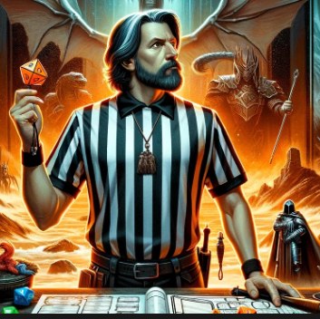
Dungeon Master
World builder
Arbiter
Scorekeeper
Notes:
Identify issues

Slide 4
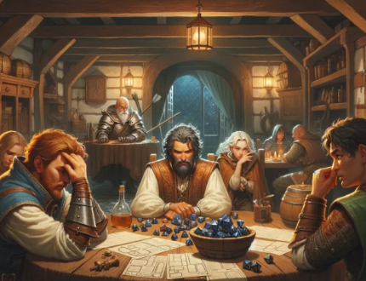
Player
Adventure seeker
Strategist
Story maker
Notes:
Identify issues

Slide 5
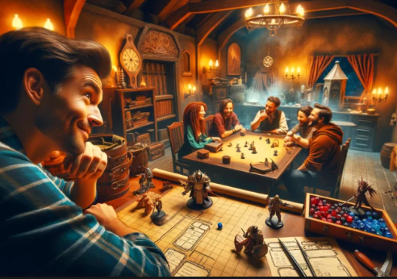
Saving the Game
Mobile First
Random Generation Tables
Initiative Tracker
Locations and NPCs
Built-in Character Sheets
Quest Log
Notes:
Include some example use cases

